Slide 1
Database design
Part 1

Slide 2
Chapter 7: Entity-Relationship Model

Slide 3
Chapter 7: Entity-Relationship Model
Design Process
Modeling
Mapping Constraints
E-R Diagram
Design Issues
Weak Entity Sets
Extended E-R Features
Design of the Bank Database
Reduction to Relation Schemas
Database Design
UML

Slide 10
Modeling
A database can be modeled as:
a collection of entities,
relationship among entities.
An entity is an object that exists and is distinguishable from other objects.
Example: person, company, event, plant, Course, Department
Entities have attributes
Example: people have names and addresses
An entity set is a set of entities of the same type that share the same properties.
Example: set of all persons, companies, trees, holidays
Notes:
PERSON, CAR, ACCIDENT, OWNS, PARTICIPATED, CUSTOMER, ORDERS, ITEM, WAREHOUSE, ORDER_ITEM, SHIPMENT, STUDENT, BOOK, COURSE, ENROLL, TEXT_ADOPTION

Slide 11
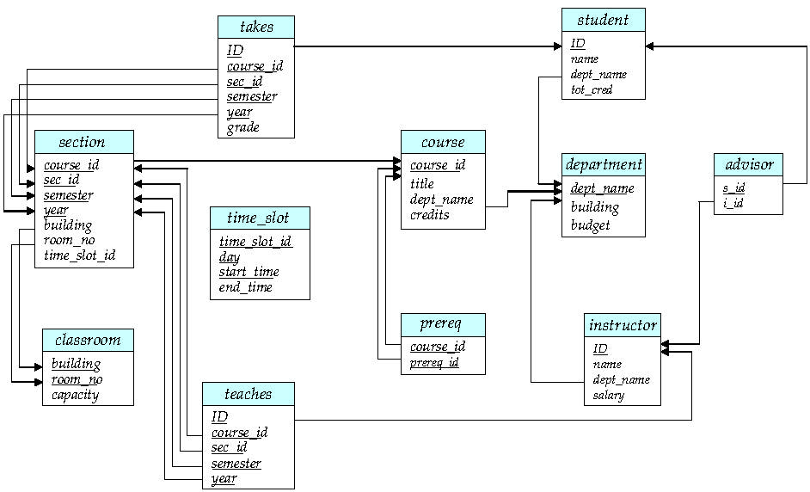

Slide 12
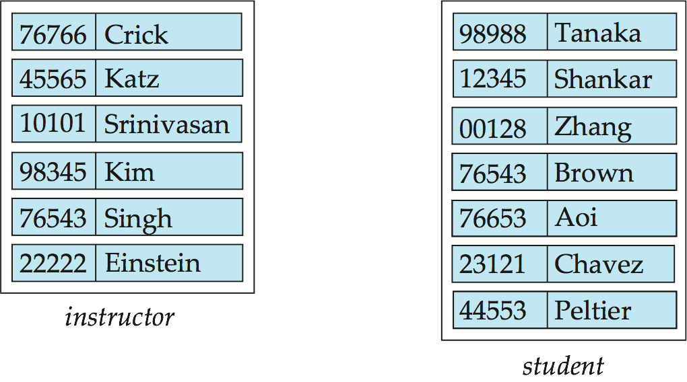
Entity Sets instructor and student
instructor_ID instructor_name student-ID student_name

Slide 13
Relationship Sets
A relationship is an association among several entities
Example: 44553 (Austin) advisor 22222 (Einstein) student entity relationship set instructor entity
A relationship set is a mathematical relation among n ≥ 2 entities, each taken from entity sets
{(e₁, e₂, … e_{n}) | e₁ ∈ E₁, e₂ ∈ E₂, …, e_{n} ∈ E_{n}} where (e₁, e₂, …, e_{n}) is a relationship
Example:
(44553,22222) ∈ advisor

Slide 14
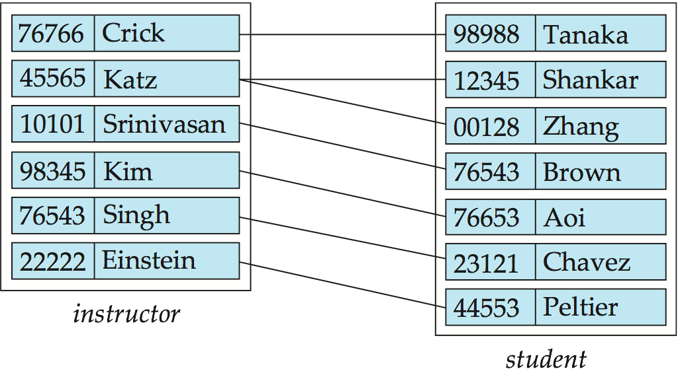
Relationship Set advisor

Slide 15
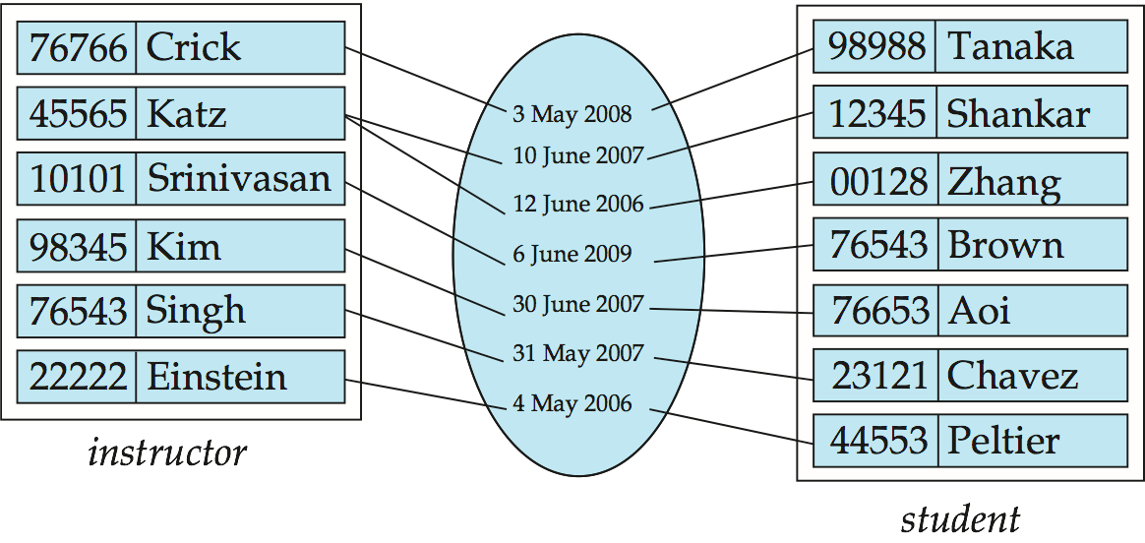
Relationship Sets (Cont.)
A descriptive attribute can also be property of a relationship set.
For instance, the advisor relationship set between entity sets instructor and student may have the attribute date which tracks when the student started being associated with the advisor

Slide 16
Degree of a Relationship Set
binary relationship
involve two entity sets (or degree two).
most relationship sets in a database system are binary.
Relationships between more than two entity sets are rare. Most relationships are binary. (More on this later.)
Example: students work on research projects under the guidance of an instructor.
relationship proj_guide is a ternary relationship between instructor, student, and project

Slide 17
Attributes
An entity is represented by a set of attributes, that is descriptive properties possessed by all members of an entity set.
Example:
instructor = (ID, name, street, city, salary ) course= (course_id, title, credits)
Domain – the set of permitted values for each attribute
Attribute types:
Simple and composite attributes.
Single-valued and multivalued attributes
Example: multivalued attribute: phone_numbers
Derived attributes
Can be computed from other attributes
Example: age, given date_of_birth

Slide 18
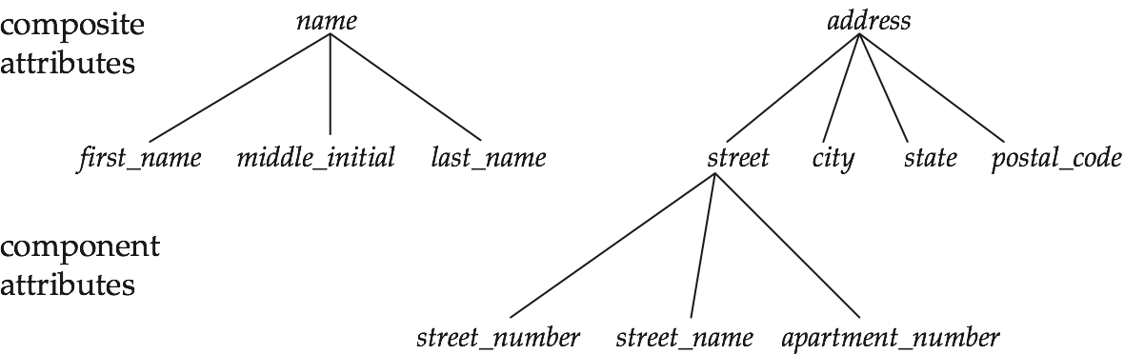
Composite Attributes

Slide 19
Mapping Cardinality Constraints
Express the number of entities to which another entity can be associated via a relationship set.
Most useful in describing binary relationship sets.
For a binary relationship set the mapping cardinality must be one of the following types:
One to one
One to many
Many to one
Many to many
Notes:
Cardinalty constrint specifies the maximum number of relation ship instance in which each entity instance can participate.
Example: advisor relationship set. i.e instructor should have minimum 2 and maximum 5 students.

Slide 20
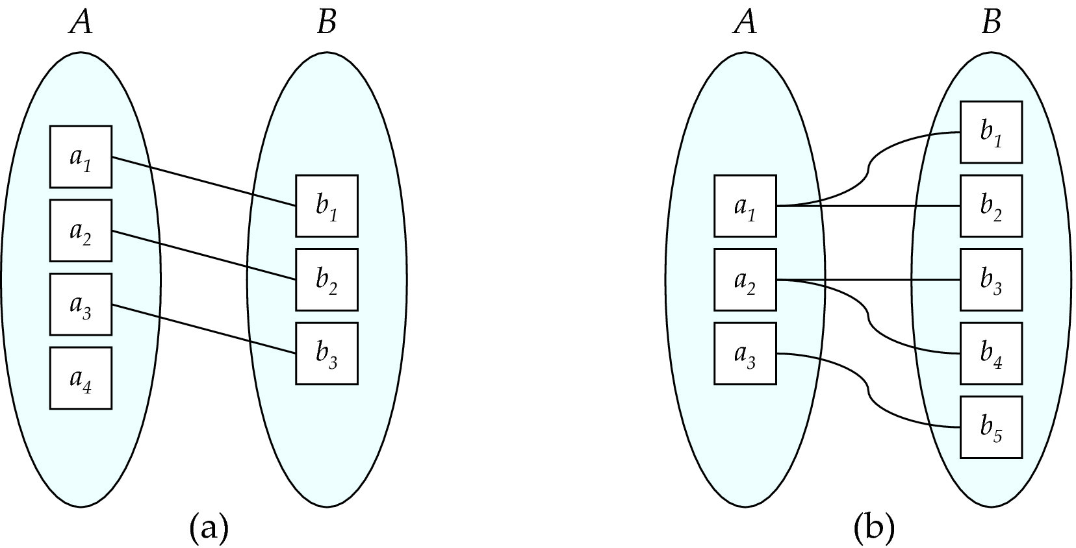
Mapping Cardinalities
One to one
One to many
Note: Some elements in A and B may not be mapped to any
elements in the other set
Notes:
Explain with Advisor relation ship .

Slide 21
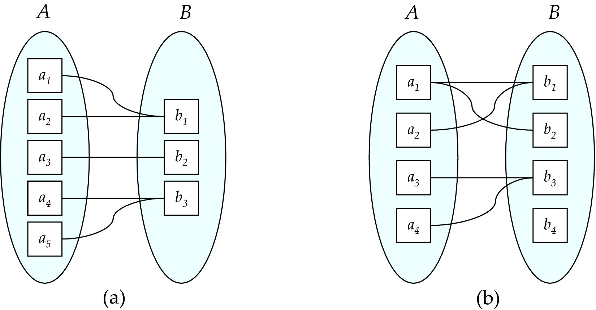
Mapping Cardinalities
Many to one
Many to many
Note: Some elements in A and B may not be mapped to any
elements in the other set

Slide 22
Keys
Key of an Entity Set
A super key of an entity set is a set of one or more attributes whose values uniquely determine each entity.
A candidate key of an entity set is a minimal super key
ID is candidate key of instructor
course_id is candidate key of course
Although several candidate keys may exist, one of the candidate keys is selected to be the primary key.

Slide 23
Keys for Relationship Sets
The combination of primary keys of the participating entity sets forms a super key of a relationship set.
(s_id, i_id) is the super key of advisor
NOTE: this means a pair of entity sets can have at most one relationship in a particular relationship set.
Example: if we wish to track multiple meeting dates between a student and her advisor, we cannot assume a relationship for each meeting. We can use a multivalued attribute though
Must consider the mapping cardinality of the relationship set when deciding what are the candidate keys

Slide 24
Redundant Attributes
Suppose we have entity sets
instructor, with attributes including dept_name
Department
and a relationship
inst_dept relating instructor and department
Attribute dept_name in entity instructor is redundant since there is an explicit relationship inst_dept which relates instructors to departments
The attribute replicates information present in the relationship, and should be removed from instructor
BUT: when converting back to tables, in some cases the attribute gets reintroduced, as we will see.

Slide 25
ER DIAGRAM
CHEN’S NOTATION

Slide 26
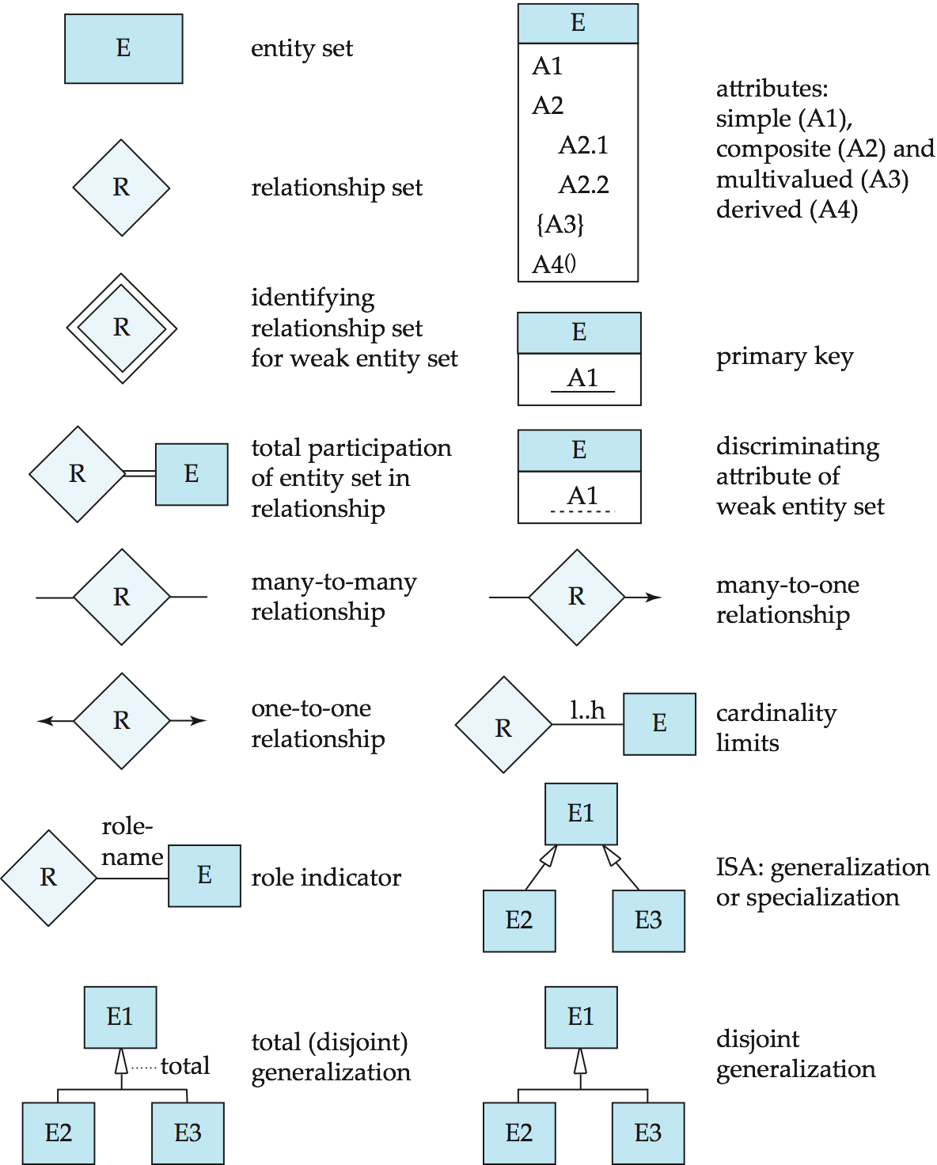
Symbols Used in E-R Notation

Slide 27
Symbols Used in E-R Notation (Cont.)

Slide 28
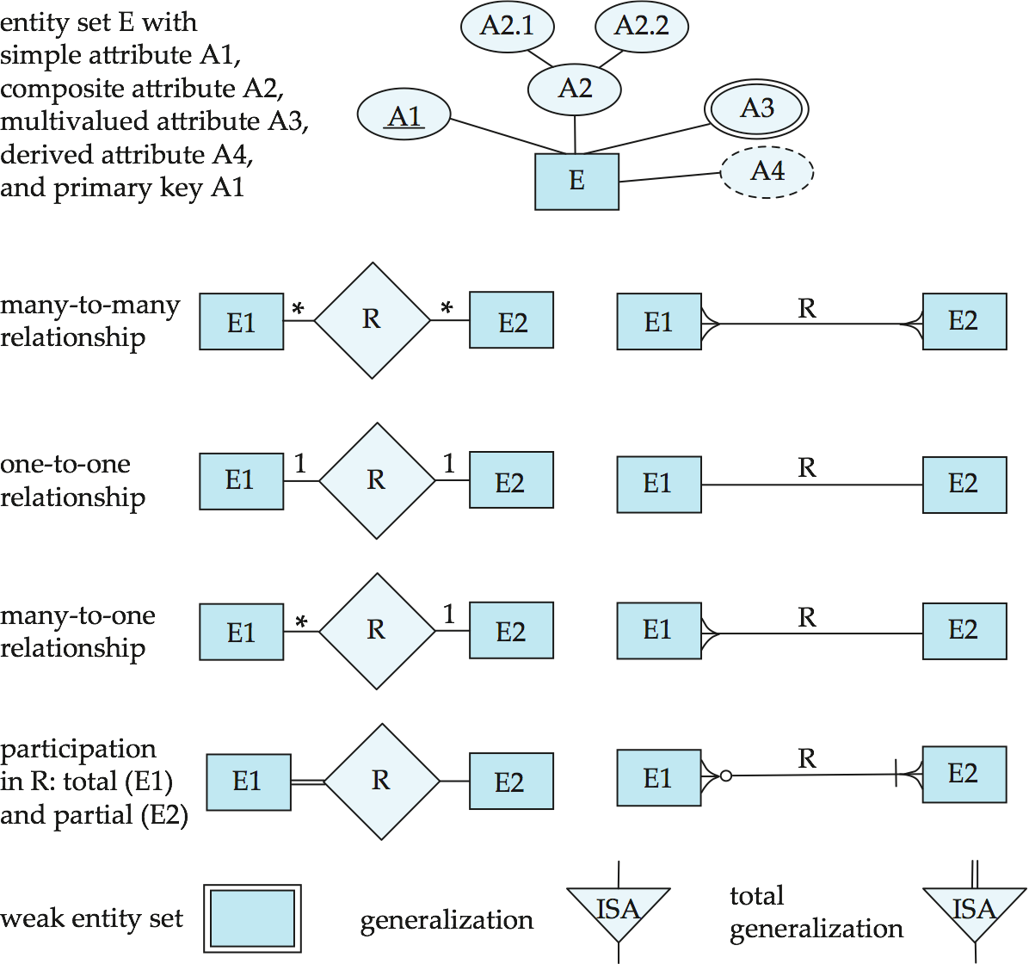
Alternative ER Notations
Chen, IDE1FX, …

Slide 29
Alternative ER Notations
Chen IDE1FX (Crows feet notation)

Slide 30
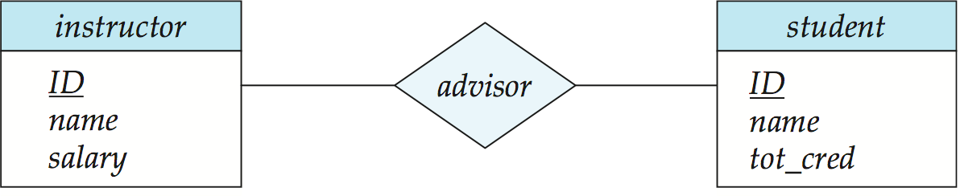
E-R Diagrams
Rectangles represent entity sets.
Diamonds represent relationship sets.
Attributes listed inside entity rectangle
Underline indicates primary key attributes

Slide 31
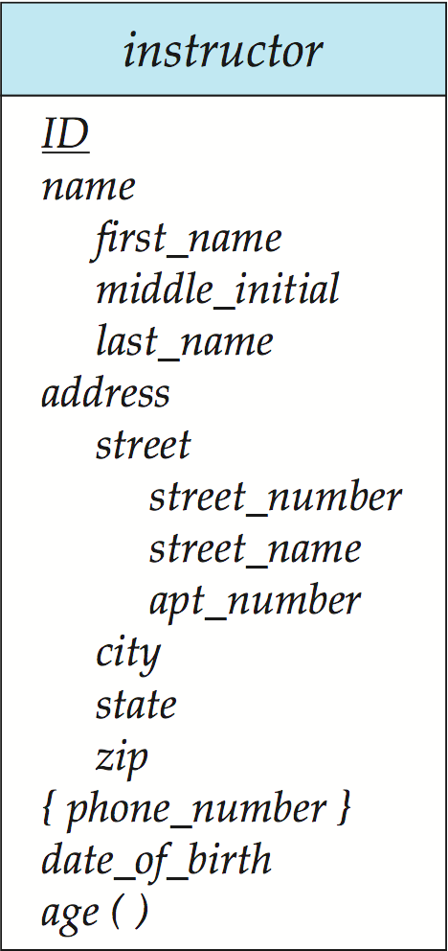
Entity With Composite, Multivalued, and Derived Attributes

Slide 32
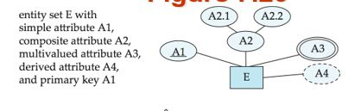

Slide 33
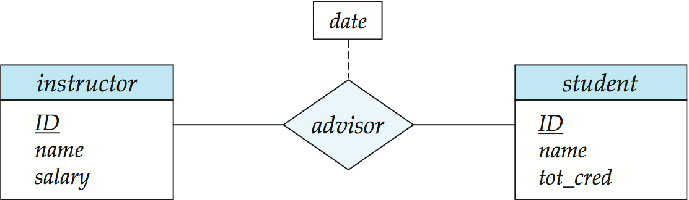
Relationship Sets with Attributes
descriptive attribute
Notes:
Discriptive attribute

Slide 34
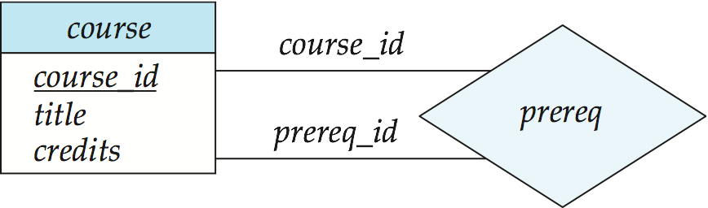
Roles
Entity sets of a relationship need not be distinct
Each occurrence of an entity set plays a “role” in the relationship
The labels “course_id” and “prereq_id” are called roles.
Course
Prerequisite Course
Notes:
Give Employee and supervisor role

Slide 35
constraints
Cardinality
participation

Slide 36
Cardinality Constraints
We express cardinality constraints by drawing either a directed line (→), signifying “one,” or an undirected line (—), signifying “many,” between the relationship set and the entity set.

Slide 37
Symbols Used in E-R Notation (Cont.)

Slide 38
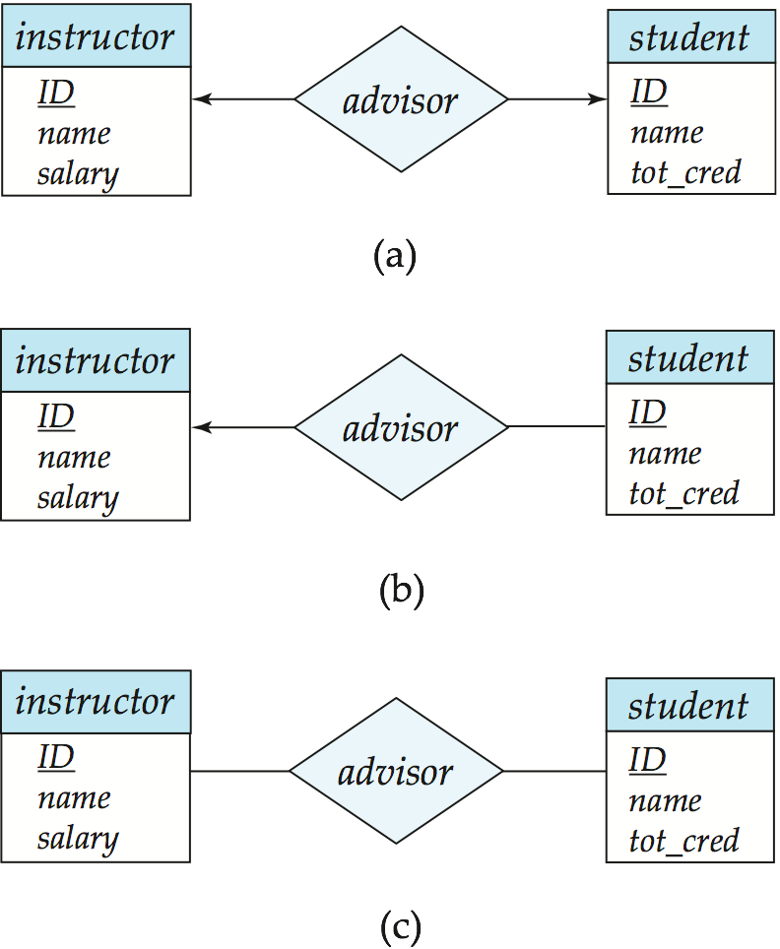
One-to-One Relationship
one-to-one relationship between an instructor and a student
an instructor is associated with at most one student via advisor
and a student is associated with at most one instructor via advisor
1
1

Slide 39
One-to-Many Relationship
one-to-many relationship between an instructor and a student
an instructor is associated with several (including 0) students via advisor
a student is associated with at most one instructor via advisor,
1
N

Slide 40
Many-to-One Relationships
In a many-to-one relationship between an instructor and a student,
an instructor is associated with at most one student via advisor,
and a student is associated with several (including 0) instructors via advisor
N
1

Slide 41
Many-to-Many Relationship
An instructor is associated with several (possibly 0) students via advisor
A student is associated with several (possibly 0) instructors via advisor
N
N

Slide 42
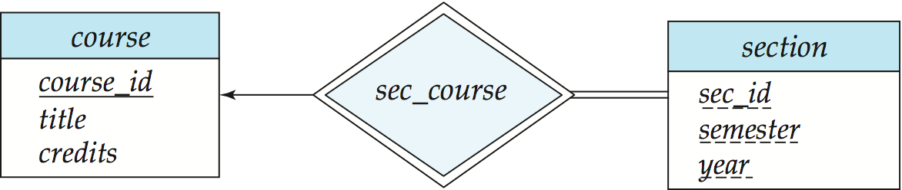
Participation of an Entity Set in a Relationship Set
Total participation (indicated by double line): every entity in the entity set participates in at least one relationship in the relationship set
E.g., participation of section in sec_course is total
every section must have an associated course
Partial participation: some entities may not participate in any relationship in the relationship set
Example: participation of instructor in advisor is partial
Total participation

Slide 45
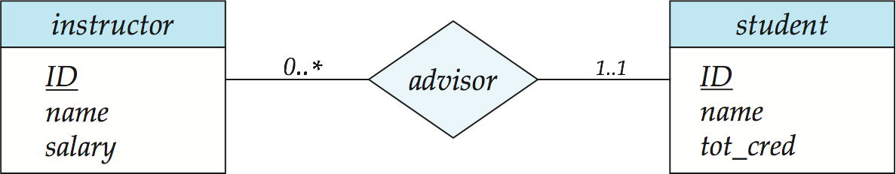
Alternative Notation for Cardinality Limits
Cardinality limits can also express participation constraints
Cardinality constraint (max)
Participation constraint
(min)
Min…max representation

Slide 46
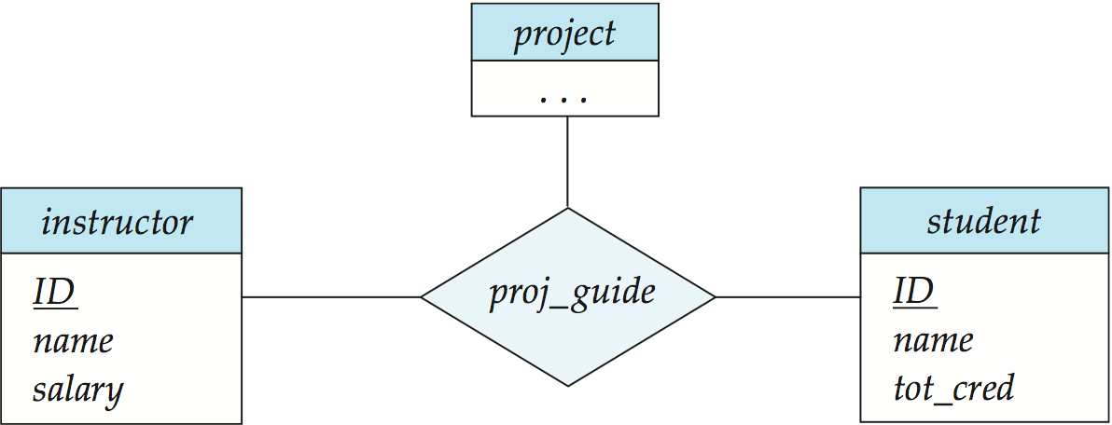
E-R Diagram with a Ternary Relationship

Slide 47
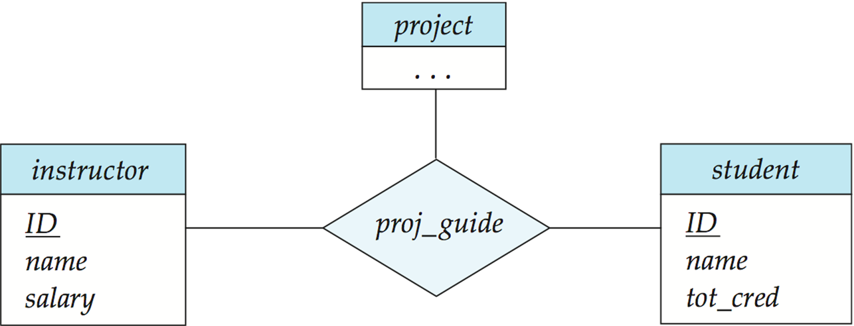
n
1
n
Notes:
Other examples for Ternary : CAR, Supplier, PART (All have ‘many’ cardinality constraints)
Student, Section and Grade report (with one as cardinality constraints)

Slide 48
Cardinality Constraints on Ternary Relationship
We allow at most one arrow out of a ternary (or greater degree) relationship to indicate a cardinality constraint
E.g., an arrow from proj_guide to instructor indicates each student has at most one guide for a project
If there is more than one arrow, there are two ways of defining the meaning.
E.g., a ternary relationship R between A, B and C with arrows to B and C could mean
1. each A entity is associated with a unique entity from B and C or
2. each pair of entities from (A, B) is associated with a unique C entity, and each pair (A, C) is associated with a unique B
Each alternative has been used in different formalisms
To avoid confusion we outlaw more than one arrow

Slide 49
Weak Entity Sets
An entity set that does not have a primary key is referred to as a weak entity set.
The existence of a weak entity set depends on the existence of a identifying entity set
It must relate to the identifying entity set via a total, one-to-many relationship set from the identifying to the weak entity set
Identifying relationship depicted using a double diamond
The discriminator (or partial key) of a weak entity set is the set of attributes that distinguishes among all the entities of a weak entity set.
The primary key of a weak entity set is formed by the primary key of the strong entity set on which the weak entity set is existence dependent, plus the weak entity set’s discriminator.

Slide 51
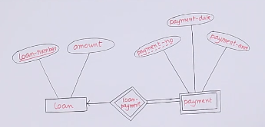
Weak Entity Sets (Cont.)
We underline the discriminator (or partial key) of a weak entity set with a dashed line.
We put the identifying relationship of a weak entity in a double diamond.
The primary key of a weak entity set is formed by the primary key of the strong entity set on which the weak entity set is existence dependent, plus the weak entity set’s discriminator.

Slide 52
Weak Entity Sets (Cont.)
Note: the primary key of the strong entity set is not explicitly stored with the weak entity set, since it is implicit in the identifying relationship.
If course_id were explicitly stored, section could be made a strong entity, but then the relationship between section and course would be duplicated by an implicit relationship defined by the attribute course_id common to course and section
Primary key for section – (course_id, sec_id, semester, year)

Slide 53
Removing redundant attributes in entity sets
Once the entities and their corresponding attributes are chosen, the relationship sets among the various entities are formed. These relationship sets may result in a situation where attributes in the various entity sets are redundant and need to be removed from the original entity sets.

Slide 54
the attribute dept name in fact gets added to the relation instructor, but only if each instructor has at most one associated department.
If an instructor has more than one associated department, the relationship between instructors and departments is recorded in a separate relation inst dept.
Ex2: sec- timeslot
And so on

Slide 55
For our university example, we list the entity sets and their attributes below, with primary keys underlined:
classroom: with attributes (building, room number, capacity).
department: with attributes (dept name, building, budget).
course: with attributes (course id, title, credits).
instructor: with attributes (ID, name, salary).
section: with attributes (course id, sec id, semester, year).
student: with attributes (ID, name, tot cred).
time slot: with attributes (time slot id, {(day, start time, end time) }).

Slide 56
The relationship sets in our design are listed below:
inst dept: relating instructors with departments.
stud dept: relating students with departments.
teaches: relating instructors with sections.
takes: relating students with sections, with a descriptive attribute grade.
course dept: relating courses with departments.
sec course: relating sections with courses.
sec class: relating sections with classrooms.
sec time slot: relating sections with time slots.
advisor: relating students with instructors.
prereq: relating courses with prerequisite courses.

Slide 57
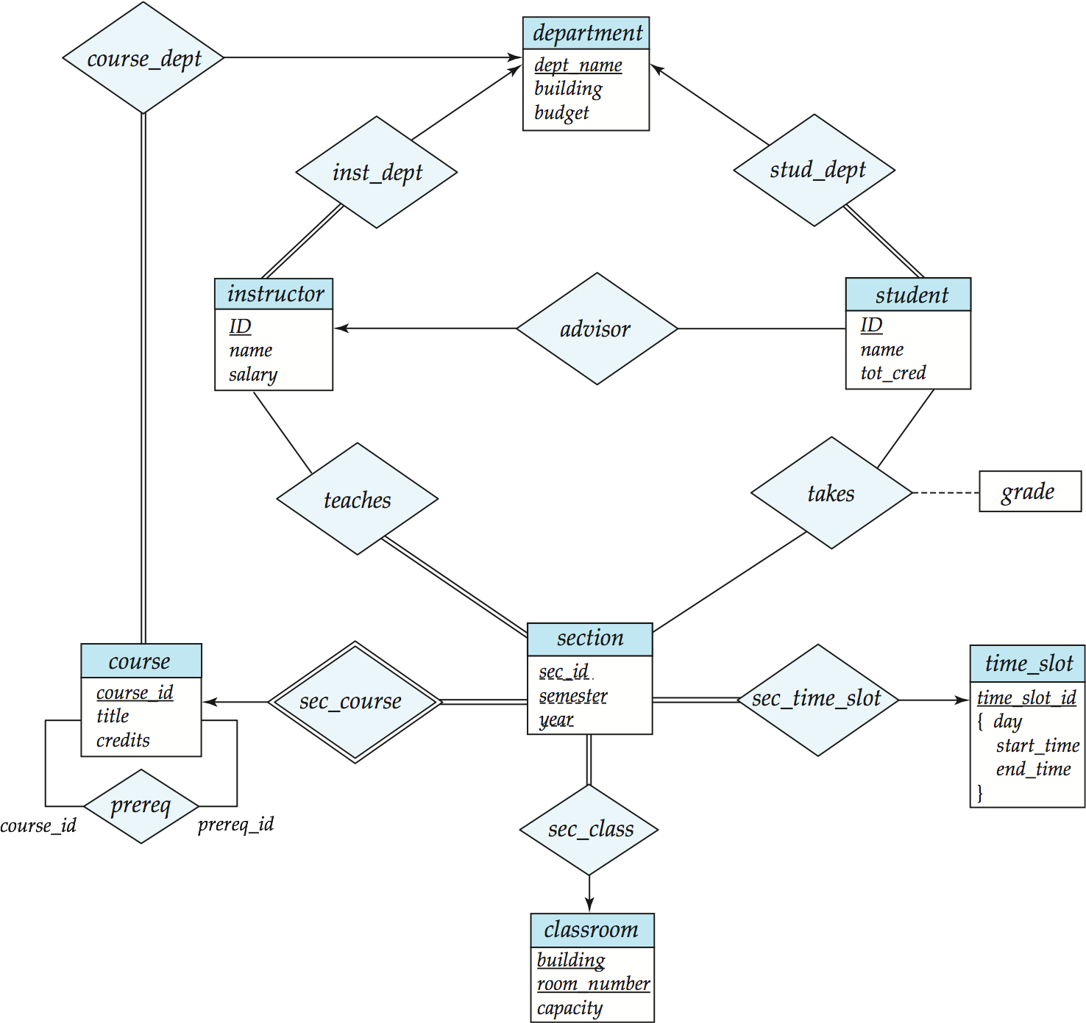
E-R Diagram for a University Enterprise
Notes:
Explain it using theses two slides and combining with both constraints and weak entity and other concepts…
If there is no total participation then relationship is converted into new table. An in case of many to many also new table.

Slide 58
ER diagram
E-R diagram can express the overall logical structure of a database graphically.
Basic structure
cardinality mapping
participation
Weak entity
Composite
mutivalued

Slide 59
Reduction to Relational Schemas

Slide 60
Reduction to Relation Schemas
Entity sets and relationship sets can be expressed uniformly as relation schemas that represent the contents of the database.
A database which conforms to an E-R diagram can be represented by a collection of schemas.
For each entity set and relationship set there is a unique schema that is assigned the name of the corresponding entity set or relationship set.
Each schema has a number of columns (generally corresponding to attributes), which have unique names.

Slide 61
Representing Relationship Sets
A many-to-many relationship set is represented as a schema with attributes for the primary keys of the two participating entity sets, and any descriptive attributes of the relationship set.
Example: schema for relationship set advisor
advisor = (s_id, i_id)
Notes:
Explain with example, what is the problem of storing the association information in the entity table.

Slide 62
Many-to-one and one-to-many relationship sets that are total on the many-side can be represented by adding an extra attribute to the “many” side, containing the primary key of the “one” side
If Partial participation: Separate table
Example: Instead of creating a schema for relationship set inst_dept, add an attribute dept_name to the schema arising from entity set instructor

Slide 63
Redundancy of Schemas (Cont.)
For one-to-one relationship sets, either side can be chosen to act as the “many” side
That is, extra attribute can be added to either of the tables corresponding to the two entity sets
If participation is partial on the “many” side, replacing a schema by an extra attribute in the schema corresponding to the “many” side could result in null values
The schema corresponding to a relationship set linking a weak entity set to its identifying strong entity set is redundant.
Example: The section schema already contains the attributes that would appear in the sec_course schema
Notes:
63

Slide 64
Representing Entity Sets With Simple Attributes
A strong entity set reduces to a schema with the same attributes student(ID, name, tot_cred)
A weak entity set becomes a table that includes a column for the primary key of the identifying strong entity set Loan_Payment ( Loan_Number, Payment_no, Pay_date, Pay_Amt )

Slide 65
Composite and Multivalued Attributes
Composite attributes are flattened out by creating a separate attribute for each component attribute
Example: given entity set instructor with composite attribute name with component attributes first_name and last_name the schema corresponding to the entity set has two attributes name_first_name and name_last_name
Prefix omitted if there is no ambiguity
Ignoring multivalued attributes, extended instructor schema is
instructor(ID, first_name, middle_initial, last_name, street_number, street_name, apt_number, city, state, zip_code, date_of_birth)
Notes:
65

Slide 66
Composite and Multivalued Attributes
A multivalued attribute M of an entity E is represented by a separate schema EM
Schema EM has attributes corresponding to the primary key of E and an attribute corresponding to multivalued attribute M
Example: Multivalued attribute phone_number of instructor is represented by a schema: inst_phone= ( ID, phone_number)
Each value of the multivalued attribute maps to a separate tuple of the relation on schema EM
For example, an instructor entity with primary key 22222 and phone numbers 456-7890 and 123-4567 maps to two tuples: (22222, 456-7890) and (22222, 123-4567)
Notes:
66

Slide 67
Multivalued Attributes (Cont.)
Special case:entity time_slot has only one attribute other than the primary-key attribute, and that attribute is multivalued
Optimization: Don’t create the relation corresponding to the entity, just create the one corresponding to the multivalued attribute
time_slot(time_slot_id, day, start_time, end_time)
Caveat: time_slot attribute of section (from sec_time_slot) cannot be a foreign key due to this optimization
Notes:
67

Slide 68
Summarizing the rule
Regular entity: schema with attributes
Weak entities: schema including strong entity PK
Composite attribute: schema is extended
Multivalued attribute: new schema with its individual attribute and PK of the parent table
Based on degree
One to one: separate schema
Many to one or one to many: schema for many side include PK of one side
Many to many: relationship is converted to schema
Based on participation:
Total participation: on many side add PK of one side
Partial participation: separate table

Slide 70
Advisor(SID, IID)
Prereq(courseid, prereqid);

Slide 71
Construct ER diagram (student work)
Each person has at most one e-mail address. Each e-mail address belongs to exactly one person.
An apartment is located in a house in a street in a city in a country.
Two teams play football against each other. A referee makes sure the rules are followed.
Construct an E-R diagram for a hospital with a set of patients and a set of medical doctors. Associate with each patient a log of the various tests and examinations conducted.
Consider a company database having each employee works for only 1 department which is managed by one of them. Department has projects running under it and assigned to a team of employees. Further employees are managed by a supervisor. Company is also interested to know the details of employee’s dependents.

